Slide 1

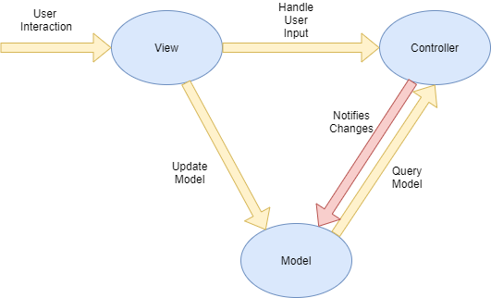
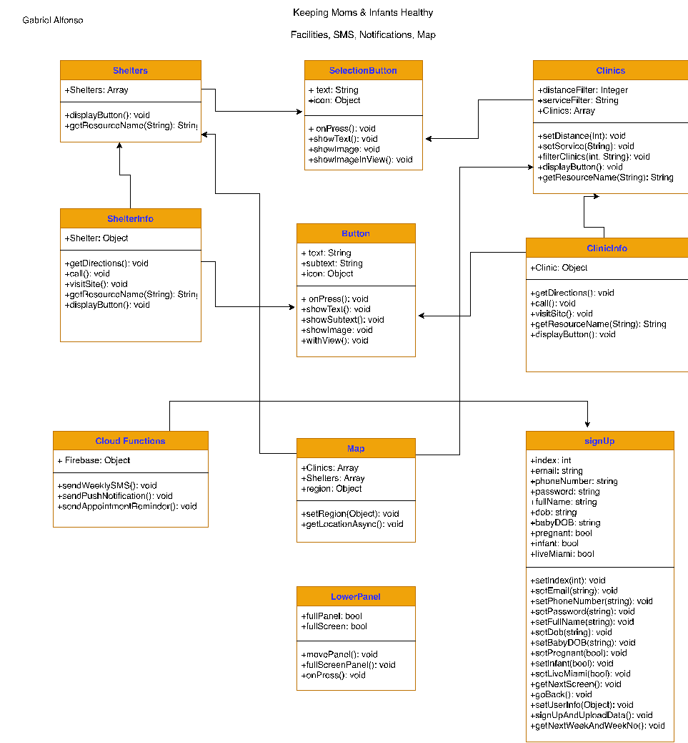





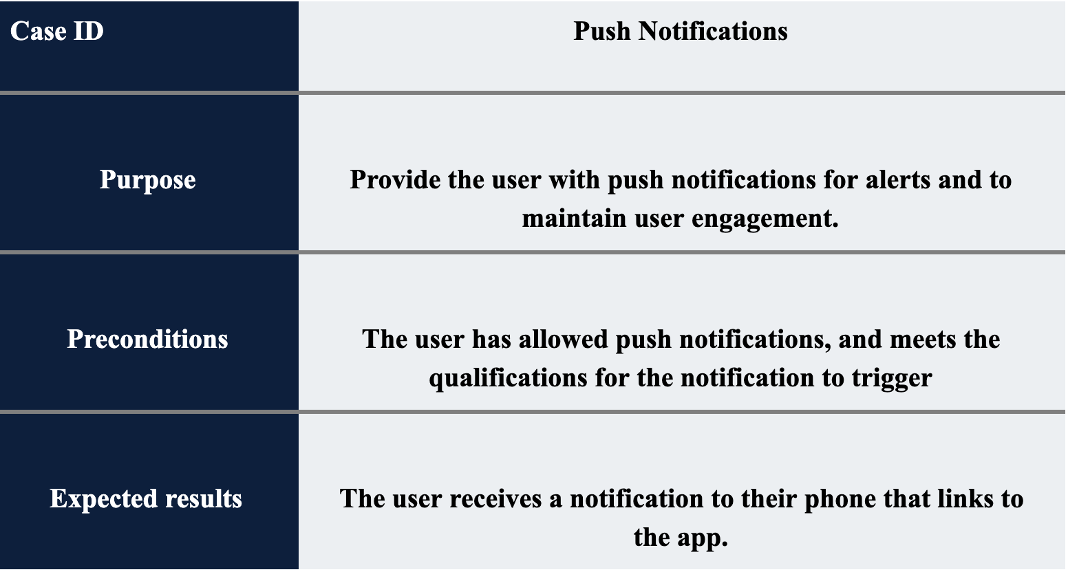
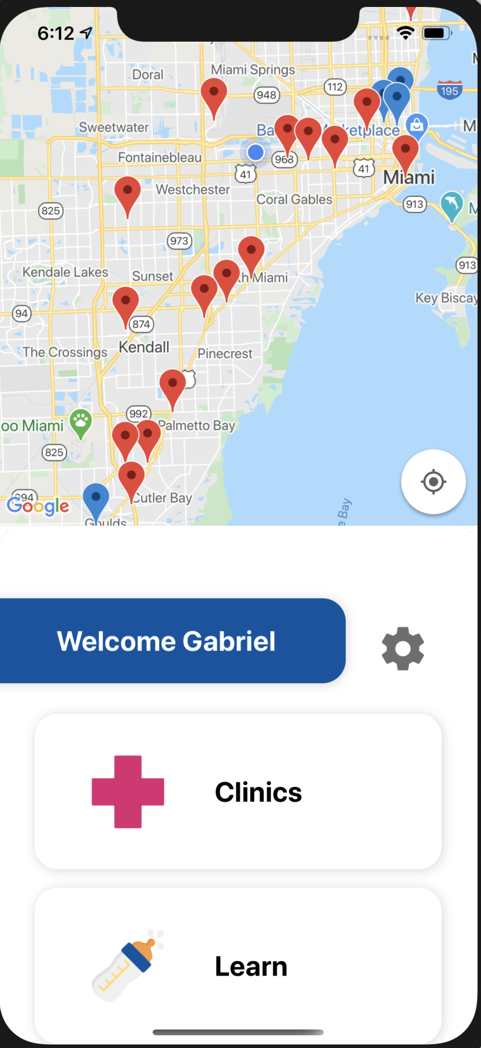
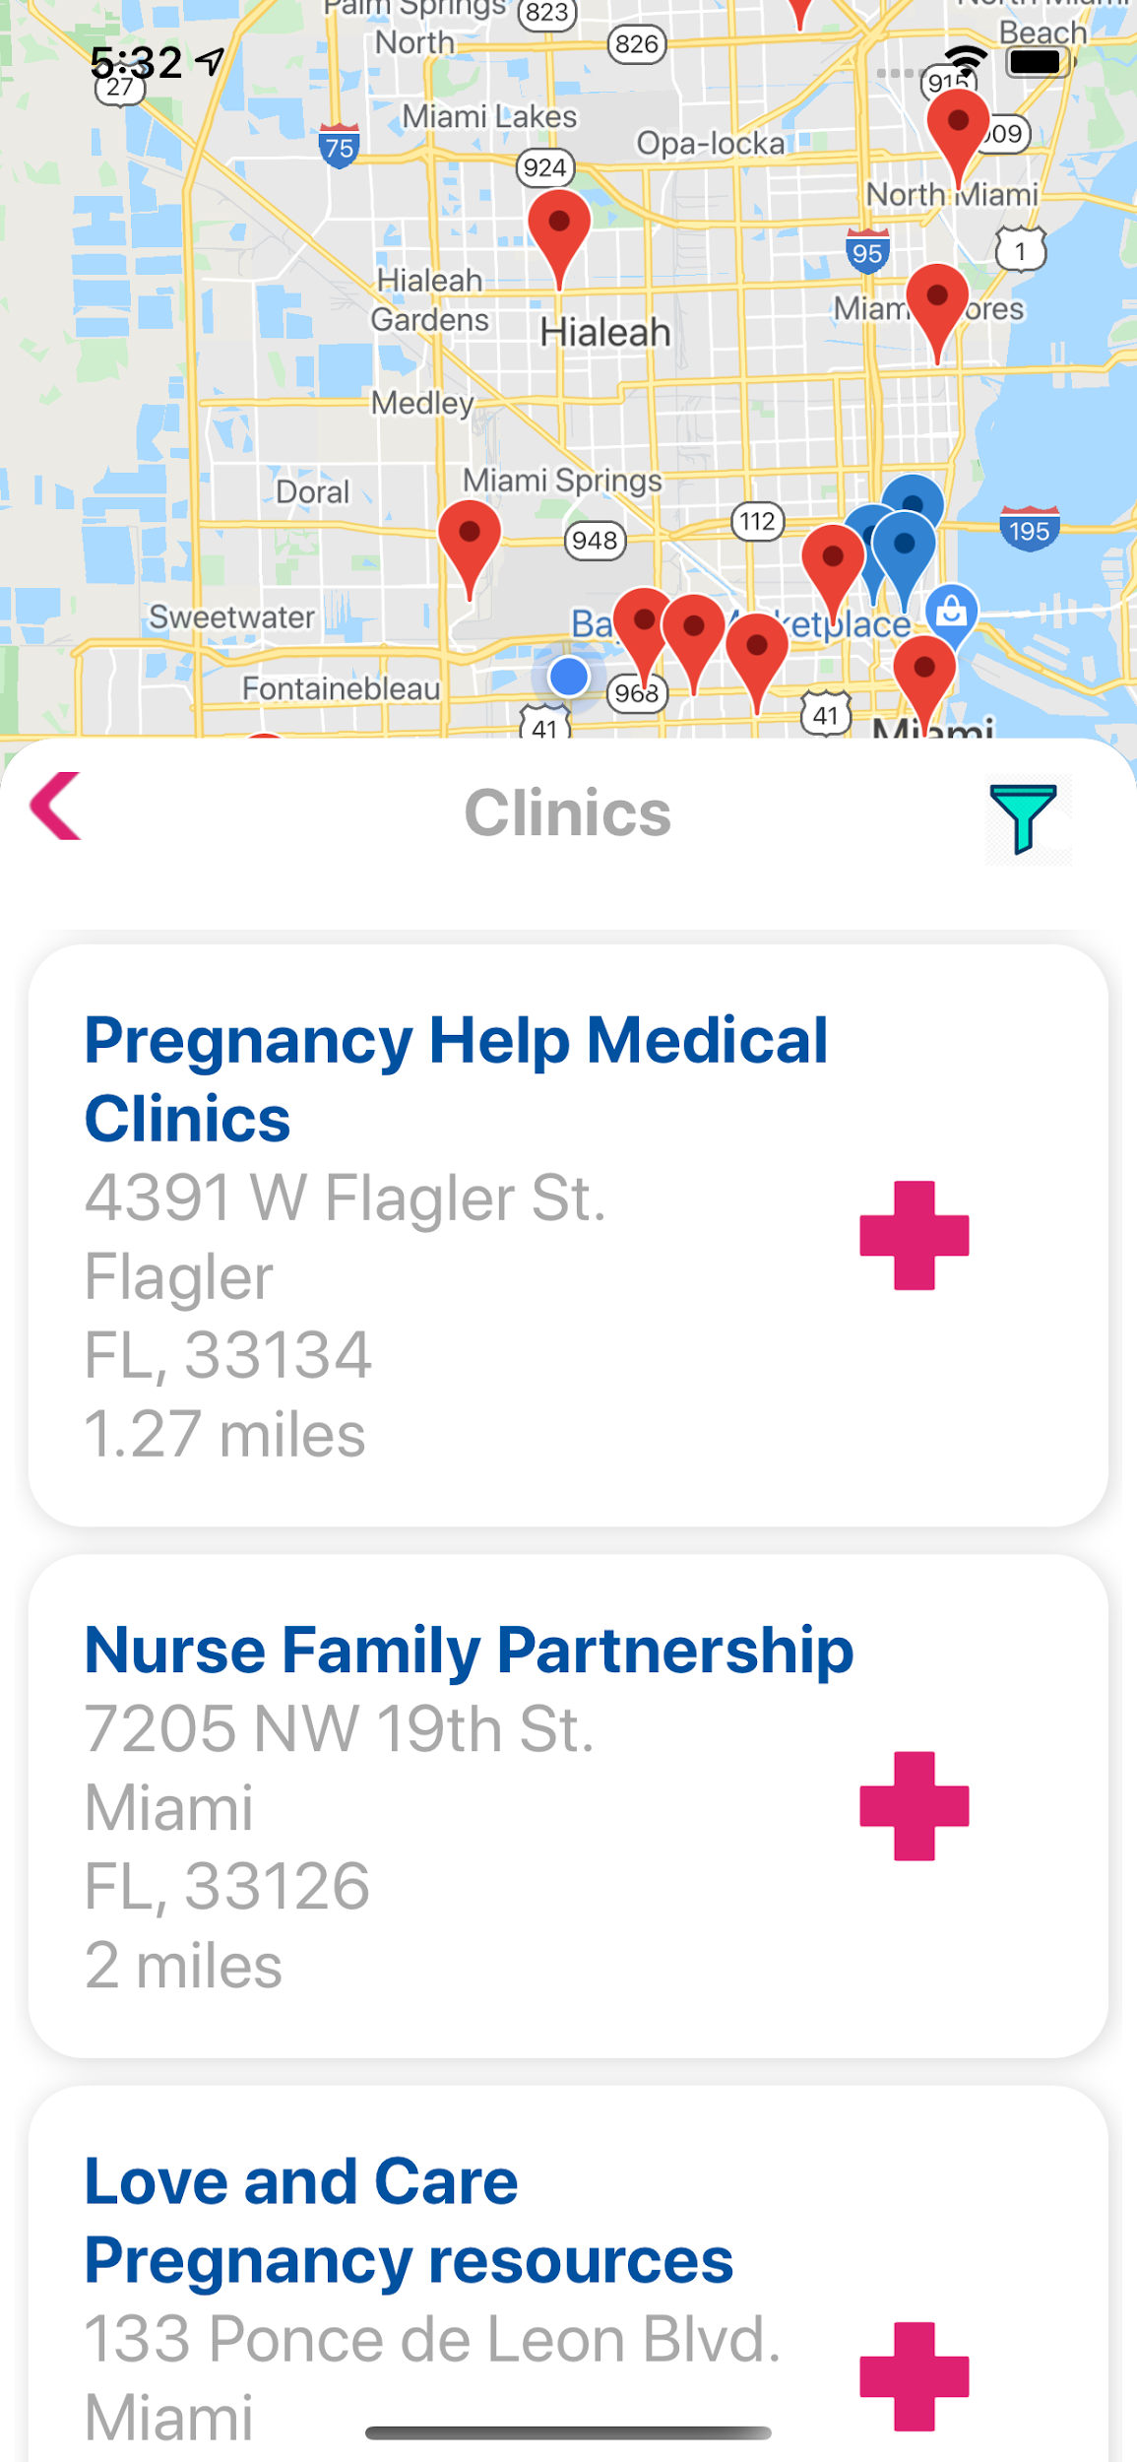
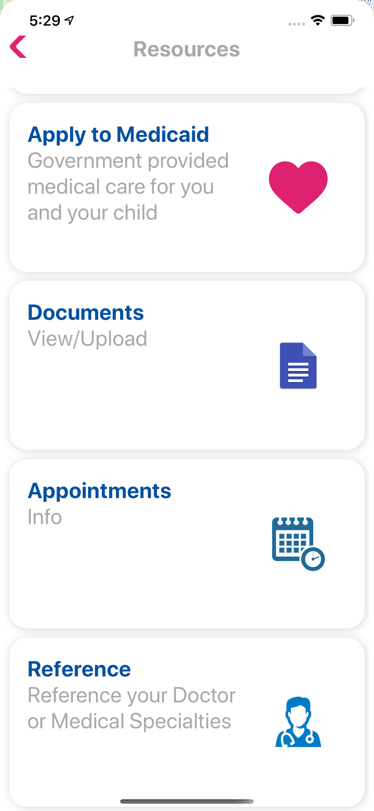
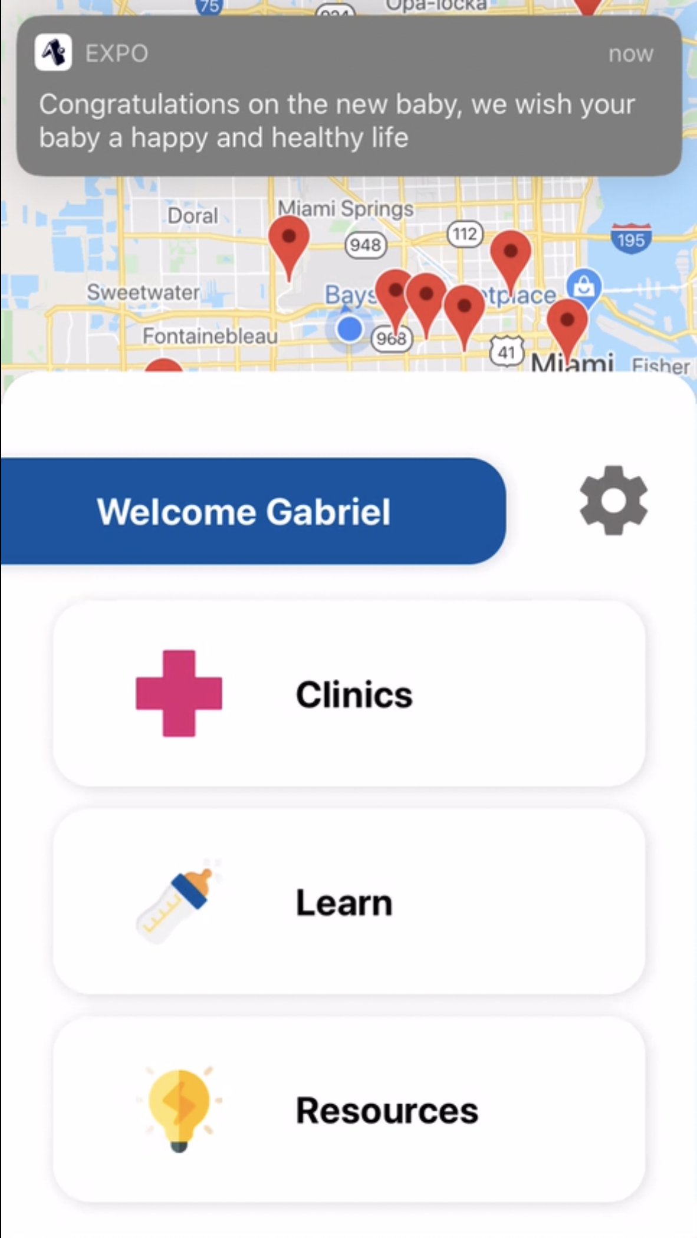
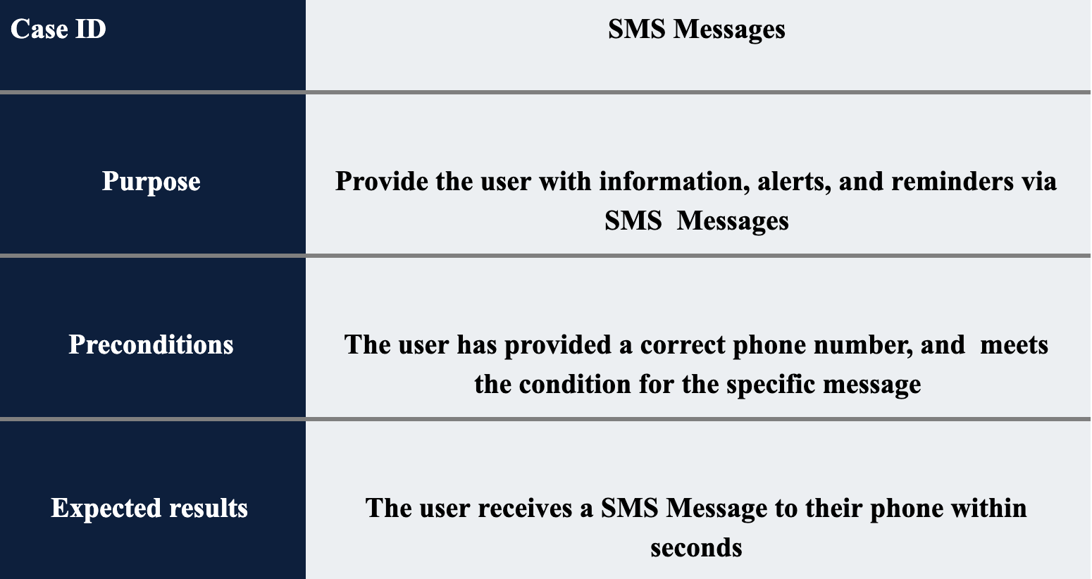
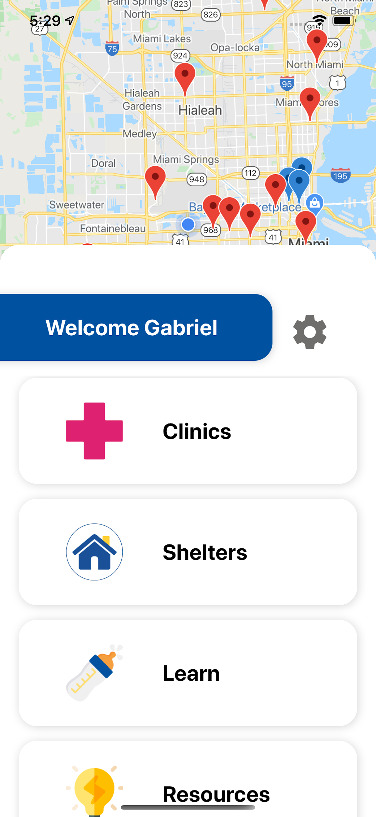
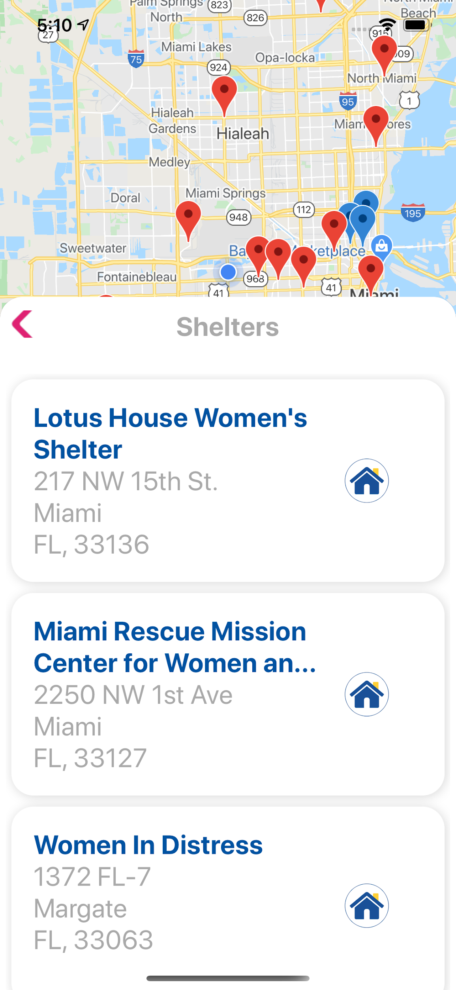

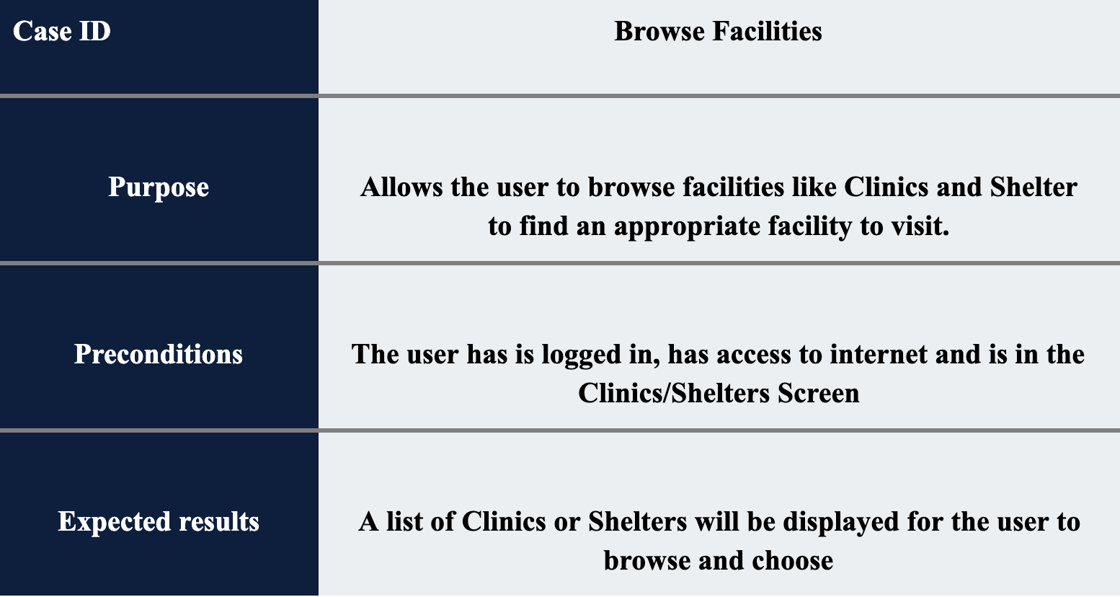
School of Computing & Information Sciences
Spring 2020 Senior Design Project
Keeping Moms & Infants Healthy
Student: Gabriel Alfonso, Florida International University
Mentor: Jean Hannan, Florida International University
Instructor: Dr. Masoud Sadjadi, Florida International University
Problem
Current System
Requirements
Low-income mothers lack proper and accurate information about pregnancy and child-caring. So they end up in the Emergency Room from simple problems. They need a source that would provide them with information and more.
The current system is very bare-bones
Provides only some of the basic features of an app.
Many features are not optimized
It provides no information about pregnancy and resources
Lacking a settings Page
Missing weekly SMS for pregnant users.
Add Information to the Learn Tab
Add Weekly SMS for pregnancy
Add Shelters to the App
Add Resources to the App
Implement Push Notifications
System Design
Object Diagram
Implementation
Verification
Screenshots
Summary
With this new version of the “Keeping Moms & Infants Healthy” app many new features have been added and optimized. The app now allows the user to sort the Clinics by proximity and even further filter by distance and service each clinic provides. A new mom would now receive weekly messages with information about child-caring. Also notifications have been added to improve user engagement.
Acknowledgement
The material in this poster is based upon the work supported by our Product Owner Dr. Jean Hannan. I thank Dr. Masoud Sadjaji for the assistance, cooperation, guidance and mentorship I received throughout this process. I also want to thank my partners Amin, Noe and Mike for the amazing help and support throughout the project

